Slide 1


OneKart
A single place to do all your biddings

Slide 2

Team Members
Rhidwan Rashid 200042149
Sian Ashsad 200042151
Kazi Jawadul Islam Jishan 200042165

Slide 3
Table of Contents
Project Description
Features
Technologies
Reflection of RDBMS

Slide 4
Description
OneKart can offer solution for a particular retailer, such as Meena Bazar, Shwapno to manage its inventory, customers, employees and branches.
The motive is to facilitate the management work in retailers, so that most of them can be carried out digitally.
OneKart can help to improve and ease interactions among customers, vendors and retailer staff.

Slide 5
Features
CRUD(Create, Read, Update, Delete) operations to and from the database.
Database keeps history of a list of orders.
Customers and vendors can search for products in the inventory of a retailer.
Products can be categorized based on their brand and type.
Customers can submit product reviews which will be available for others to see.

Slide 6







Technologies
Frontend: ReactJS + CSS
Backend: NodeJS + Express
Database: MySQL
Version Control : GitHub

Slide 7
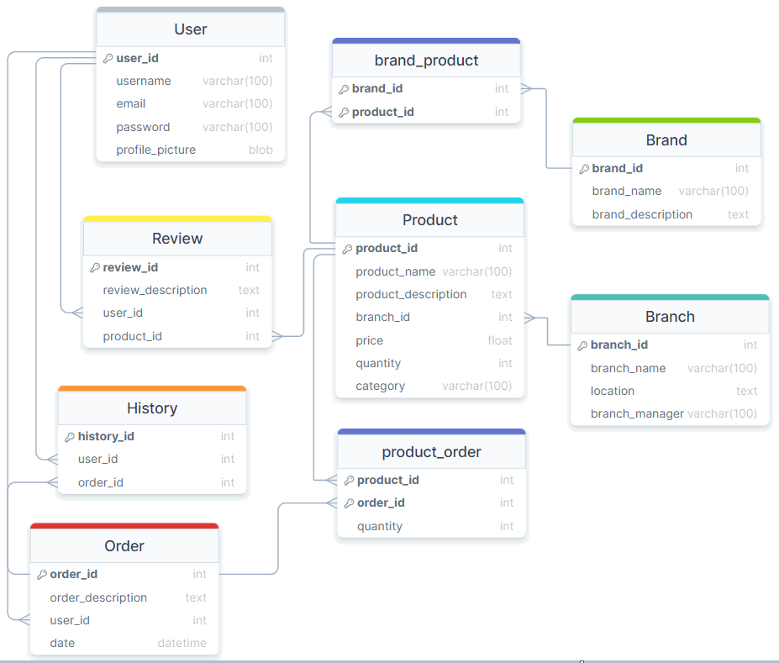
Reflection of RDBMS via ER Diagram

Slide 8
Thank You!

